Slide 1
introduction RNA-sequencing data Analysis
W. Evan Johnson, Ph.D.
Boston University
@wejlab
October 9, 2019

Slide 2
Objective:
Disclaimer: non-comprehensive introduction to RNA-sequencing
Introduce preprocessing steps
Visualization
Analytical methods
Common software tools

Slide 4
Steps to an RNA-seq Analysis (Literacy)
Step 1: Preprocessing and QC:
Fasta and Fastq files
FastQC: good vs. bad examples
Visualization
Step 2: Alignment
Obtaining genome sequence and annotation
Software:
Bowtie, TopHat, STAR, Subread/Rsubread
Step 3: Expression Quantification
Count reads hitting genes, etc
Approaches/software:
HT-Seq, STAR, Cufflinks, RPKM FPKM or CPM, RSEM, edgeR, findOverlaps (GenomicRanges). featureCounts (Rsubread)
Step 4: More visualization
Heatmaps, boxplots, PCA, t-SNE, UMAP
Step 5: Differential Expression
Batch correction
Overdispersion
General Workflow
Available tools:
edgeR, DESeq, Limma/voom
Even more visualization!!

Slide 5
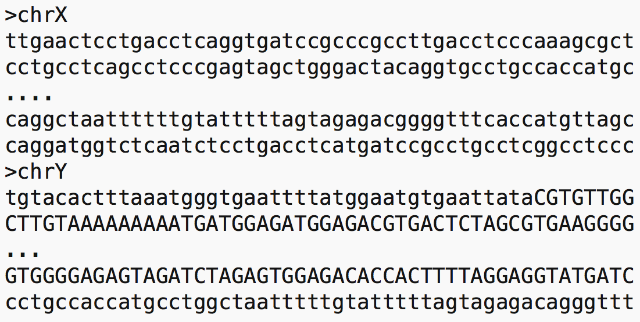
Fasta format

Slide 6
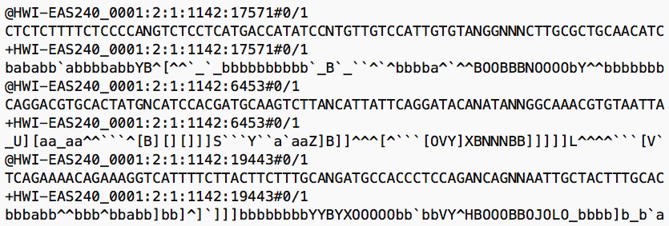
Fastq format

Slide 7
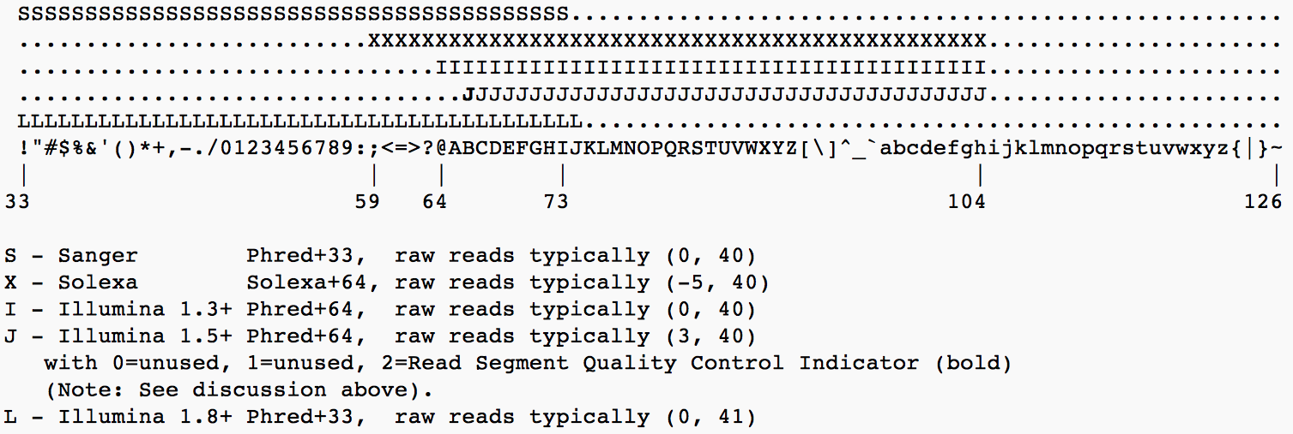
Fastq encodings

Slide 8
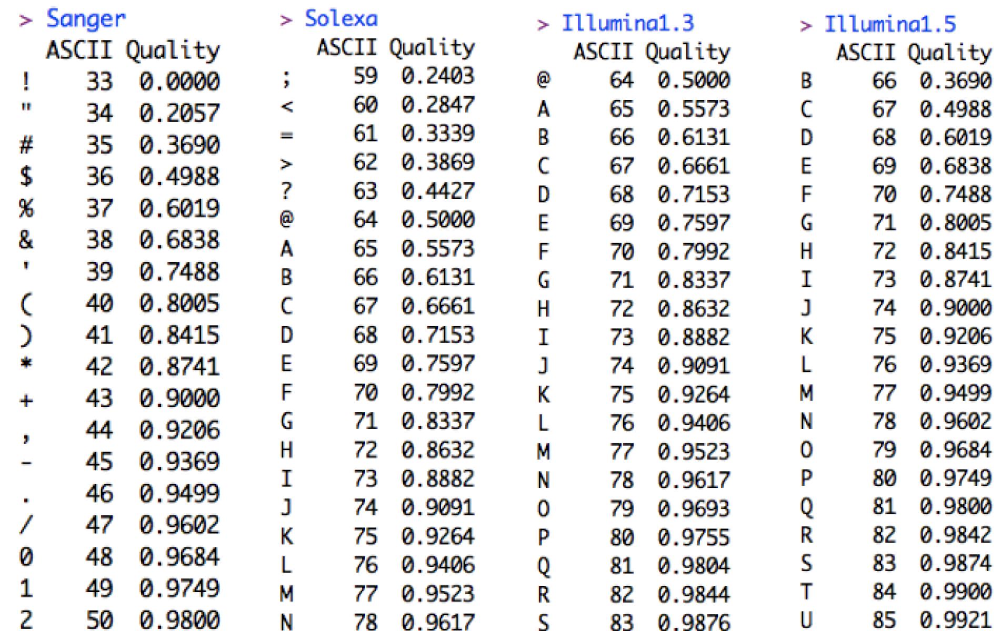
Fastq encodings

Slide 9
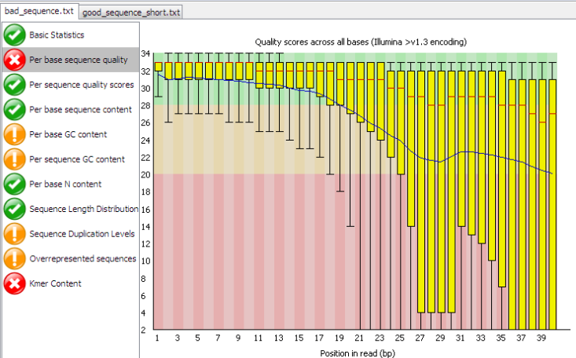
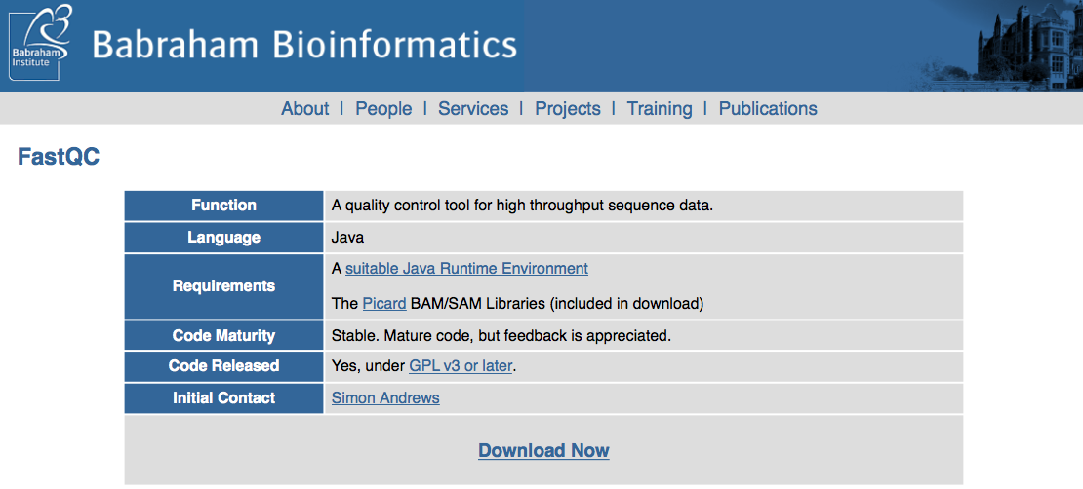
Preprocessing and QC using FASTQC
FastQC provides a simple way to do QC checks on raw sequence
http://www.bioinformatics.babraham.ac.uk/projects/fastqc/
Import of data from BAM, SAM or FastQ files
Quick overview and summary graphs and tables to quickly assess your data
Export of results to an HTML based permanent report
Offline operation to allow automated generation of reports without running the interactive application

Slide 10
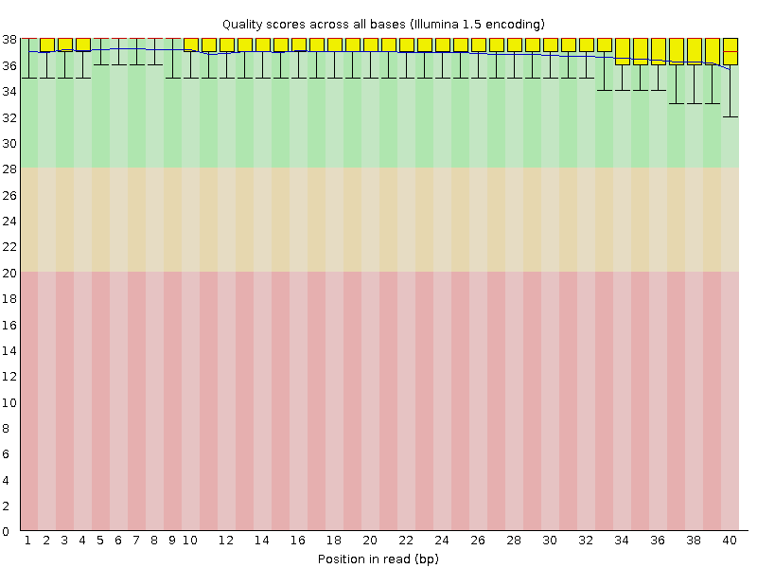
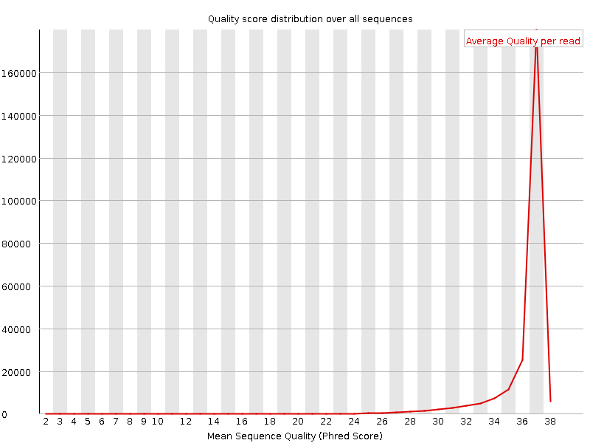
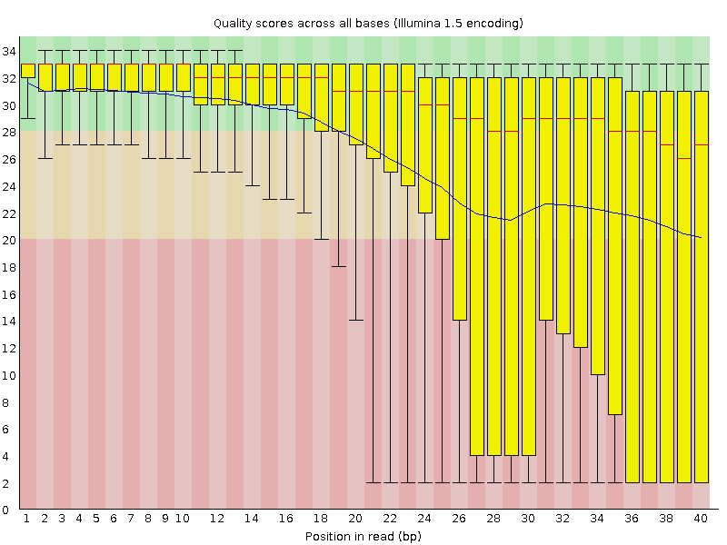
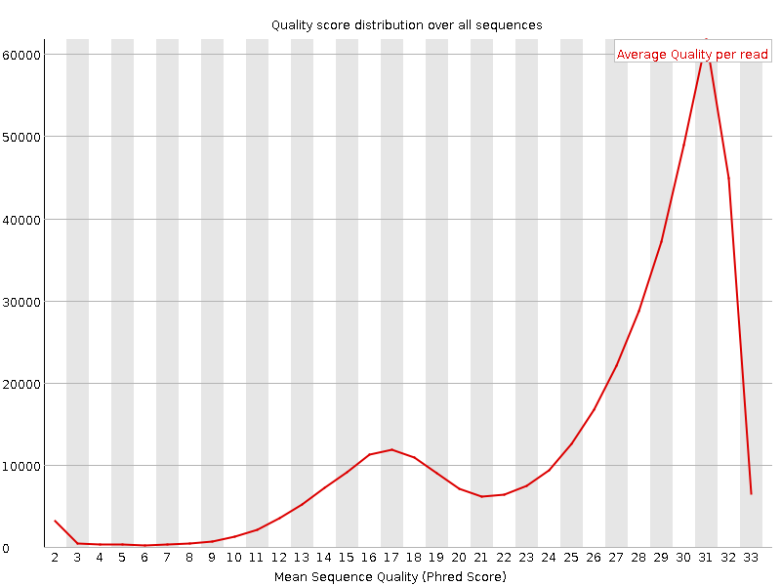
FastQC Read Quality: Good vs. bad
Quality scores
Quality score distribution
Good
Good
Bad
Bad

Slide 11
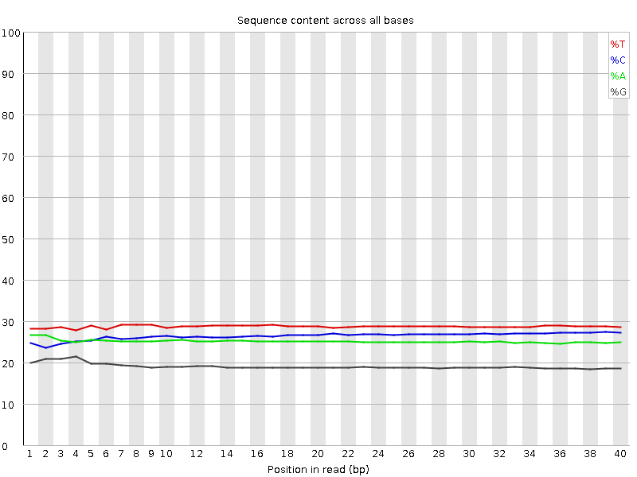
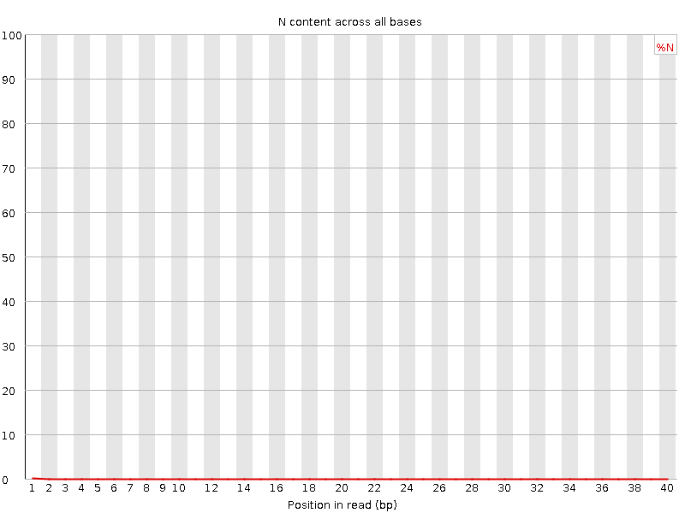
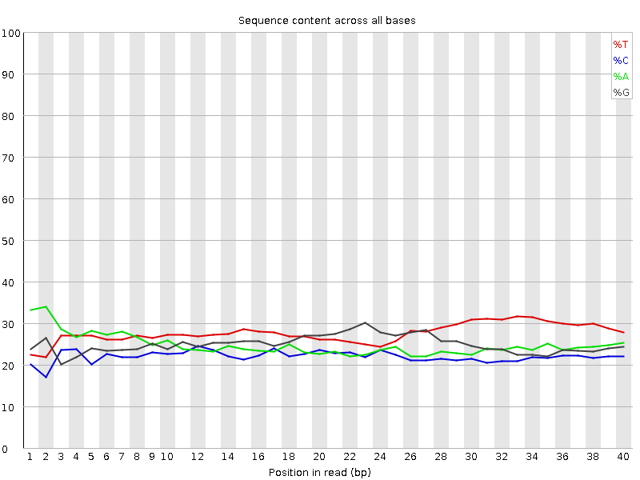
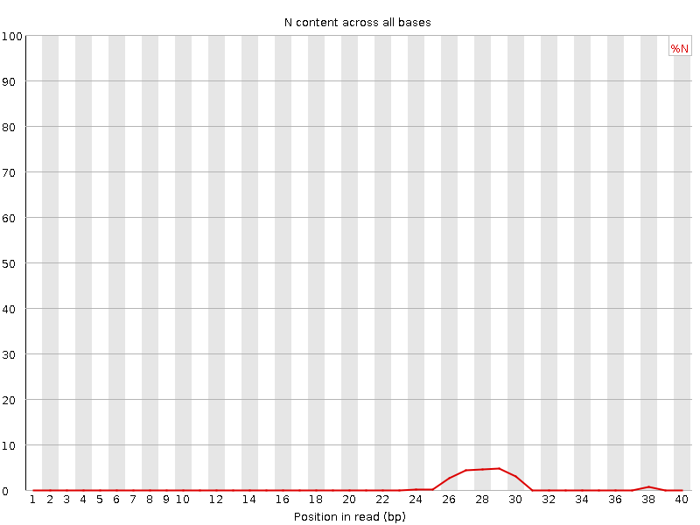
FastQC Read Quality: Good vs. bad
Quality scores
Quality score distribution
Good
Good
Bad
Bad

Slide 12
Alignment to the Reference Genome
Find the genomic Location of origin for the sequencing read
Software: Bowtie2, TopHat, STAR, Subread/Rsubread, many others!

Slide 13
Create a genome index
Hash Table
CCCAGTGCCACGGAGCGAACAGTGGTGAAAGCTCGCAGTGTT
Genome

Slide 14
Create a genome index
Hash Table
CCCAG:1
CCCAGTGCCACGGAGCGAACAGTGGTGAAAGCTCGCAGTGTT
Genome

Slide 15
Create a genome index
Hash Table
CCCAG:1
CCAGT:2
CCCAGTGCCACGGAGCGAACAGTGGTGAAAGCTCGCAGTGTT
Genome

Slide 16
Create a genome index
Hash Table
CCCAG:1
CCAGT:2
CAGTG:3,20,45
CCCAGTGCCACGGAGCGAACAGTGGTGAAAGCTCGCAGTGTT
Genome

Slide 17
Create a genome index
Hash Table
CCCAG:1
CCAGT:2
CAGTG:3,20,45
...
GTGTT:47
CCCAGTGCCACGGAGCGAACAGTGGTGAAAGCTCGCAGTGTT
Genome

Slide 18
Align the reads to the genome
Read
Hash Table
Hash Table
CCCAG:1
CCAGT:2
CAGTG:3,20,45
...
GTGTT:47
CAGTGCC
CCCAG:1
CCAGT:2
CAGTG:3,20,45
...
GTGTT:47
CCCAGTGCCACGGAGCGAACAGTGGTGAAAGCTCGCAGTGTT
Genome
Genome

Slide 19
Align the reads to the genome
Read
Hash Table
Hash Table
CCCAG:1
CCAGT:2
CAGTG:3,20,45
...
GTGTT:47
CAGTGCC
CCCAG:1
CCAGT:2
CAGTG:3,20,45
...
GTGTT:47
CCCAGTGCCACGGAGCGAACAGTGGTGAAAGCTCGCAGTGTT
Genome
Genome

Slide 20
Align the reads to the genome
Read
Hash Table
Hash Table
CCCAG:1
CCAGT:2
CAGTG:3,20,45
...
GTGTT:47
CAGTGCC
CCCAG:1
CCAGT:2
CAGTG:3,20,45
...
GTGTT:47
CCCAGTGCCACGGAGCGAACAGTGGTGAAAGCTCGCAGTGTT
Genome
Genome
Genome
Genome

Slide 21
Align the reads to the genome
Read
Hash Table
Hash Table
CCCAG:1
CCAGT:2
CAGTG:3,20,45
...
GTGTT:47
CAGTGCC
CCCAG:1
CCAGT:2
CAGTG:3,20,45
...
GTGTT:47
CAGTGCC
|||||||
CAGTGCC
||||||
CAGTGCC
|||||
CCCAGTGCCACGGAGCGAACAGTGCTGAAAGCTCGCAGTGTT
Score=7
Score=5
Score=3
Genome
Genome
Genome
Genome

Slide 22
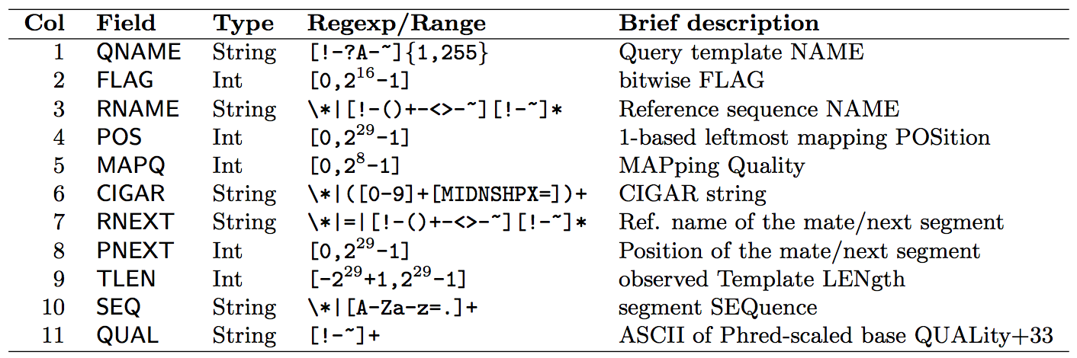
Sam and Bam format

Slide 23
Feature Counts
Count reads hitting genes, etc
Approaches/software:
HT-Seq
STAR
Cufflinks
RPKM FPKM or CPM
RSEM
edgeR
findOverlaps (GenomicRanges)
featureCounts (Rsubread)

Slide 24
Lessons to learn from batch effects
Batch Effect: Non-biological variation due to differences in batches of data that confound the relationships between covariates of interest.
Caused by differences in:
Gene expression profiling platform
Lab protocol or experimenter
Time of day or processing
Atmospheric ozone level (Rhodes et al. 2004)

Slide 25
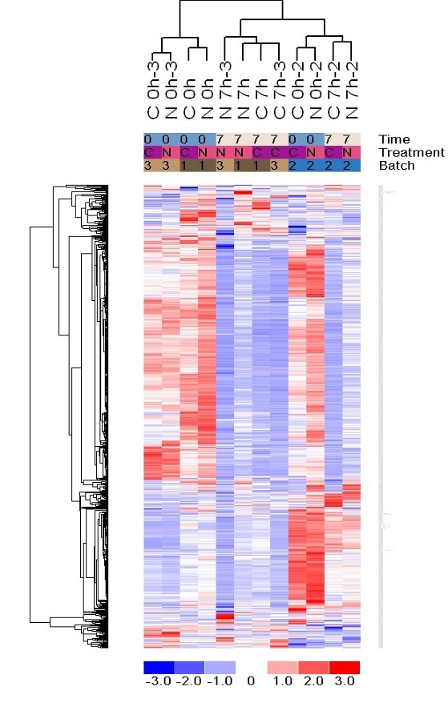
Batch effect example #1

Slide 26
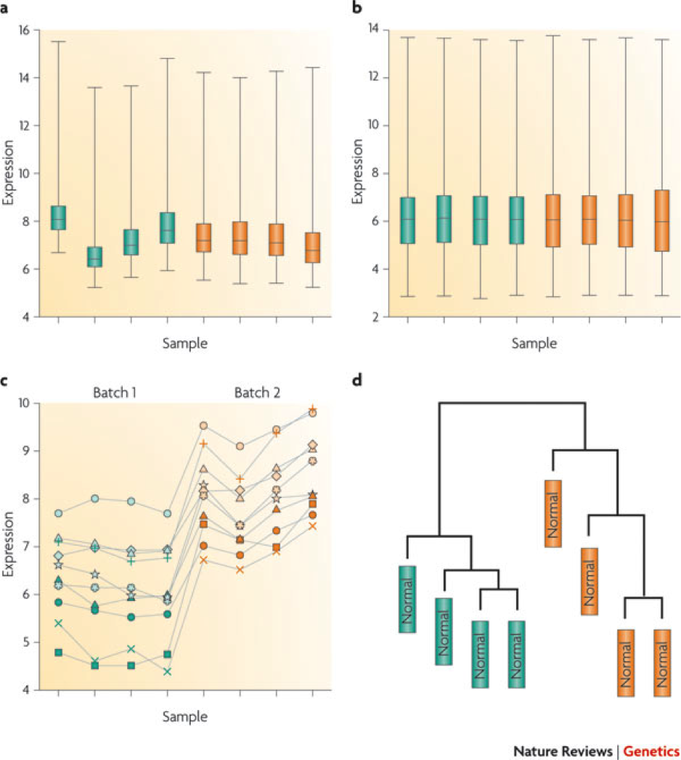
More batch effect examples
Example #3: Proteomic markers to predict endometriosis (39 total)
Single peptide predictors of disease (AUC): 0.82, 0.76, 0.74, 0.74, 0.70 (+12 more >0.6)
Single peptide predictors of batch (AUC): 0.99, 0.94, 0.91, 0.86, 0.86, 0.84, 0.84, 0.84, 0.83, 0.82 (+7 more >0.6)
Predict batch better than disease!

Slide 27
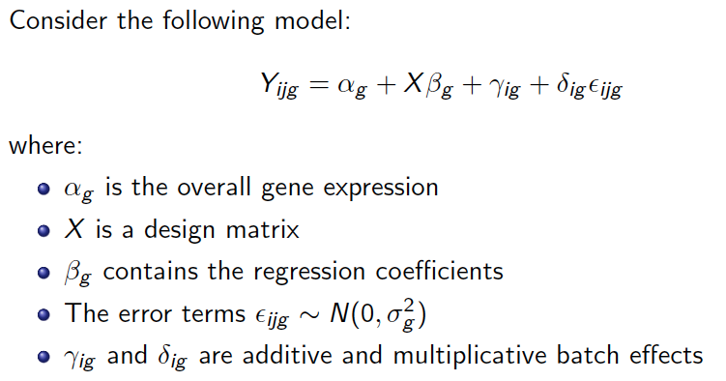
Modeling batch effects

Slide 28
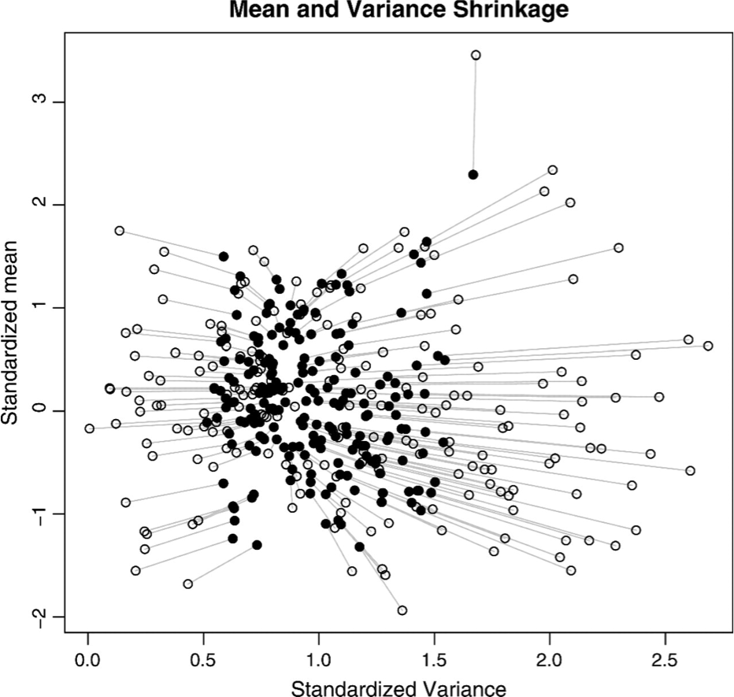
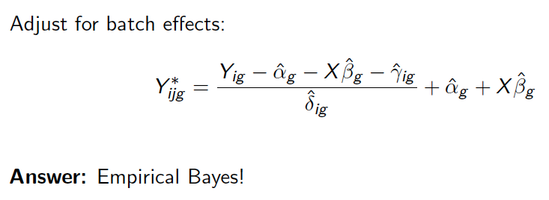
Adjusting for batch effects

Slide 29
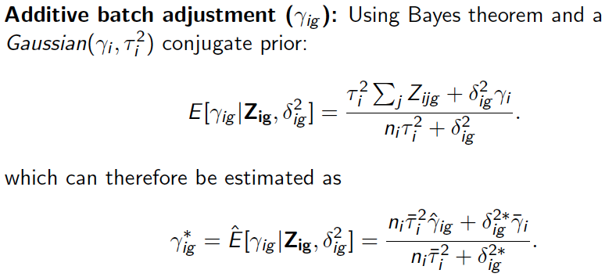
Adjusting batch mean differences

Slide 30
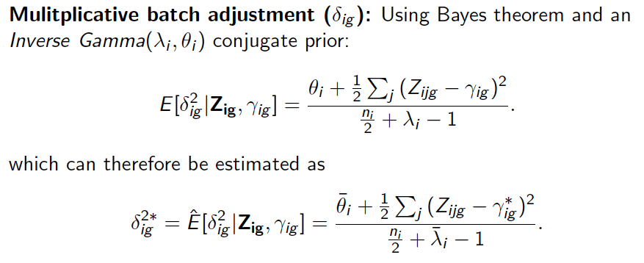
Adjusting batch Variances

Slide 31
Normalization methods
Need to normalize data because of:
Sequencing depth difference in each RNA sample
RNA composition differences
Highly expressed genes can consume a substantial proportion of RNA-Seq reads, causing other genes to be under-sampled
RNA population 1
RNA population 2
Assuming equal sequencing depth, yellow and blue will get lower RPKM in RNA population 1 although they have equal expression levels
Different methods
Trimmed mean of M-values (edgeR/limma)
Median of Ratios method (DESeq)

Slide 32
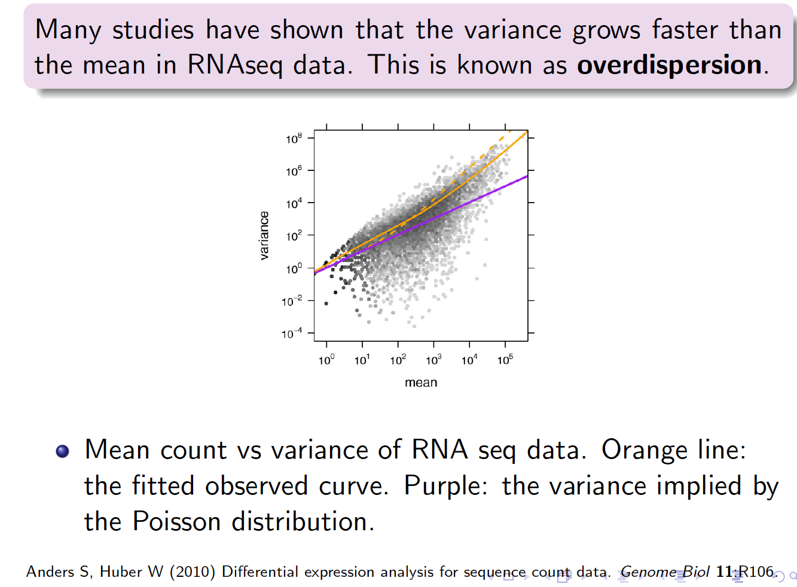
The problem of overdispersion
Alignment and feature counting result in discrete count data (i.e. the number of reads to each gene)
A first thought might be to use a Poisson distribution to model the counts
However, the Poisson makes a strict mean-variance assumption (i.e. they are the same
Studies have demonstrated that a negative binomial fits data better
Software use:
Negative binomial distribution
Non-parametric methods
Voom transformation

Slide 33
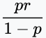
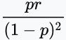
Negative Binomial review:
Probability Mass Function:
Mean:
Variance:

Slide 34
Available Negative Binomial methods:
EdgeR:
DeSeq2:
Another option is to transform your data (logCPM, voom)!

Slide 35
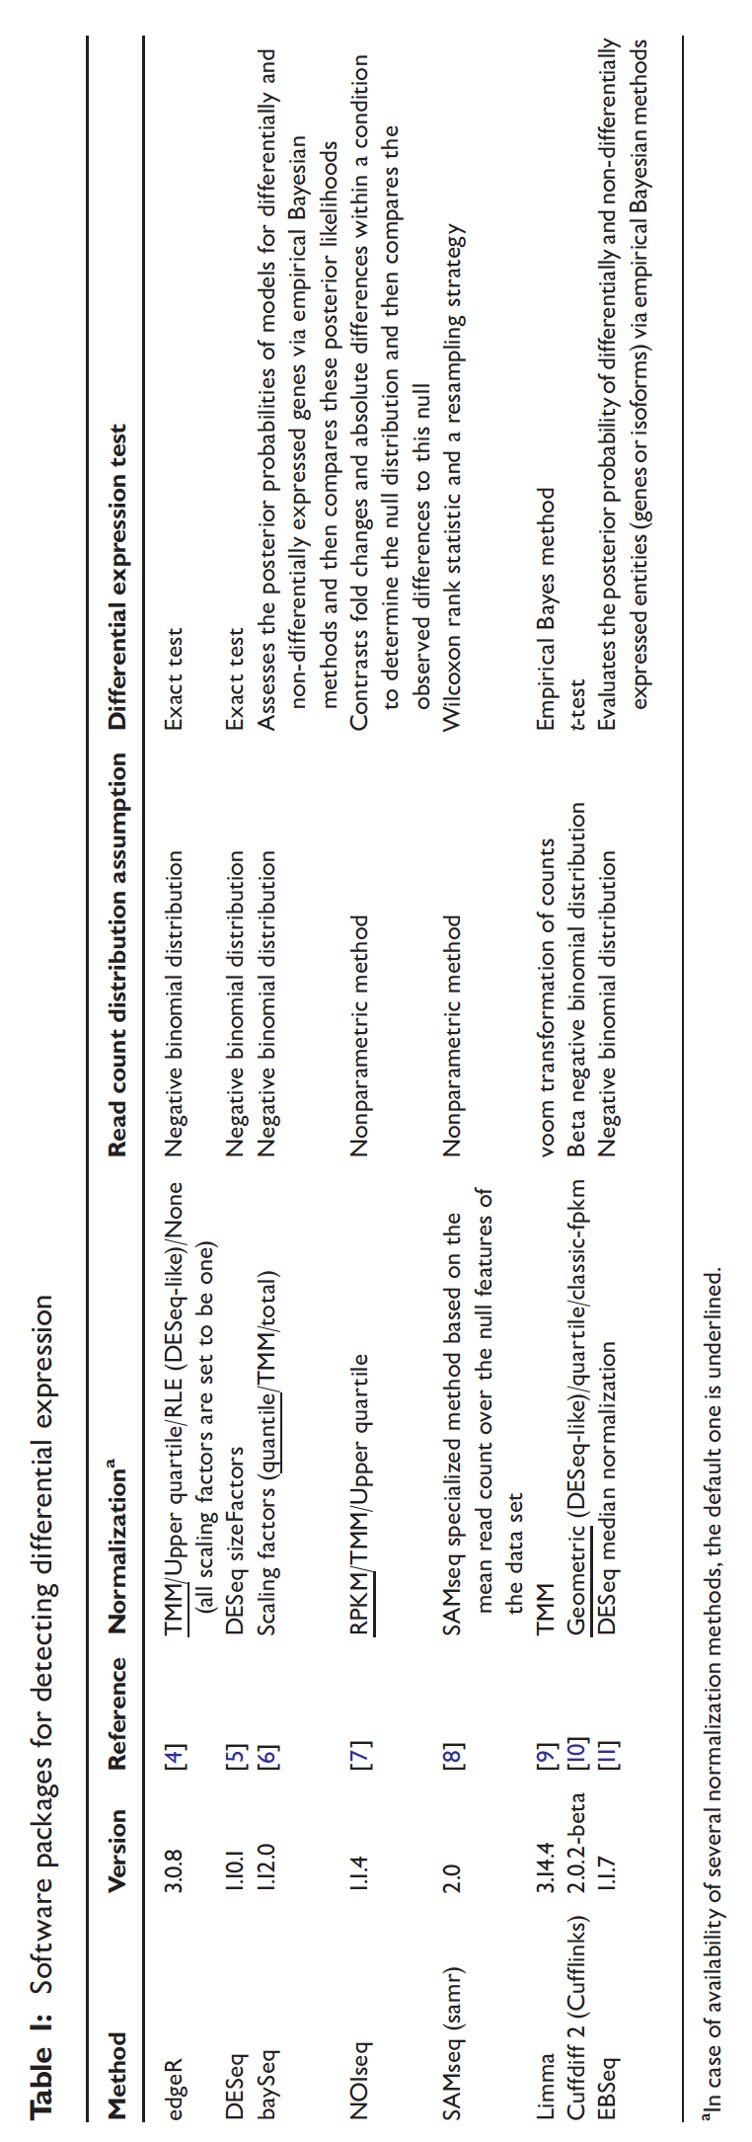
Methods for differential expression

Slide 36
EdgeR Example:
Implements statistical methods for DE analysis based on the negative binomial model
#start with a count matrix
counts<-counts[which(rowSums(cpm(counts)>1),] #Gene Filtering
dge <- DGEList(counts=counts, group=group) #Computes library size
counts<-counts[which(rowSums(cpm(counts)>1),] #Gene Filtering
dge <- DGEList(counts=counts, group=group) #Re-compute library size
dge <- calcNormFactors(dge) #TMM normalization
design<-model.matrix(~group)
dge<-estimateDisp(y,design) #Estimates common, trended and tagwise dispersion
In negative binomial models, each gene is given a dispersion parameter. Dispersions control the variances of the gene counts and underestimation will lead to false discovery and overestimation may lead to a lower rate of true discovery
#perform likelihood ratio tests
fit<-glmFit(y,design) #fits a negative binomial GLM with the dispersion estimates
lrt<-glmLRT(fit, coef=2) #Performs likelihood ratio test, comparing the goodness of the fit of the full versus reduced model
topTags(lrt)
#perform quasi-likelihood F-tests
#Replace the chisquare approximation to the likelihood ratio statistic with a quasi-likelihood F-test, more control of error rate
fit<-glmQLFit(y, design) #use for small dataset, reflects uncertainty in estimating dispersion for each gene, more robust and reliable error rate #control when the number of replicates is small
qlf<-glmQLFTest(fit, coef=2)
topTags(qlf)
#For visualization, heatmaps/PCA
Logcpm<-cpm(y,log=TRUE)

Slide 37
DeSeq2 Example:
Differential expression analysis using negative binomial generalized linear models
Similar to edgeR with normalization strategy being different
Dds <- DESeqDataSetFromMatrix(countData = countData, colData=colData, design=~group)
#colData is a data frame of demographic/phenotypic data
dds<-dds[rowSums(counts(dds))>1,] #Gene Filtering
dds<-DESeq(dds) #Performs estimation of size factors,dispersion, and negative binomial GLM f#itting
res<-results(dds)
#data transforms for visualization, heatmaps/PCA
Rld<-rlog(dds, blind=FALSE)
Vsd<-varianceStabilizingTransform(dds, blind=FALSE)

Slide 38
Limma/Voom
Most similar to microarray data flow
Reads counts are converted to log2 counts per million (logCPM) and the mean-variance relationship is modeled with precision weights (voom transform)
dge <- DGEList(counts=counts, group=group) #From edgeR, Computes library size
counts<-counts[which(rowSums(cpm(counts)>1),] #Gene Filtering
dge <- DGEList(counts=counts, group=group) #Re-compute library size
dge <- calcNormFactors(dge) #TMM normalization
design<-model.matrix(~group)
v<-voom(dge, design) #voom transform to calculate weights to eliminate mean-variance #relationship
#use usual limma pipelines
fit<-lmFit(v,design)
fit<-eBayes(fit)
topTable(fit, coef=ncol(design))

Slide 39
Network and pathway analysis
After finding DEGs, look for correlated genes/networks and enriched pathway sets in the gene set
Weighted gene coexpression network analysis (WGCNA)
GSEA, GSVA, EnrichR, many more!!
Qiagen Ingenuity Pathway Analysis (IPA)

Slide 40
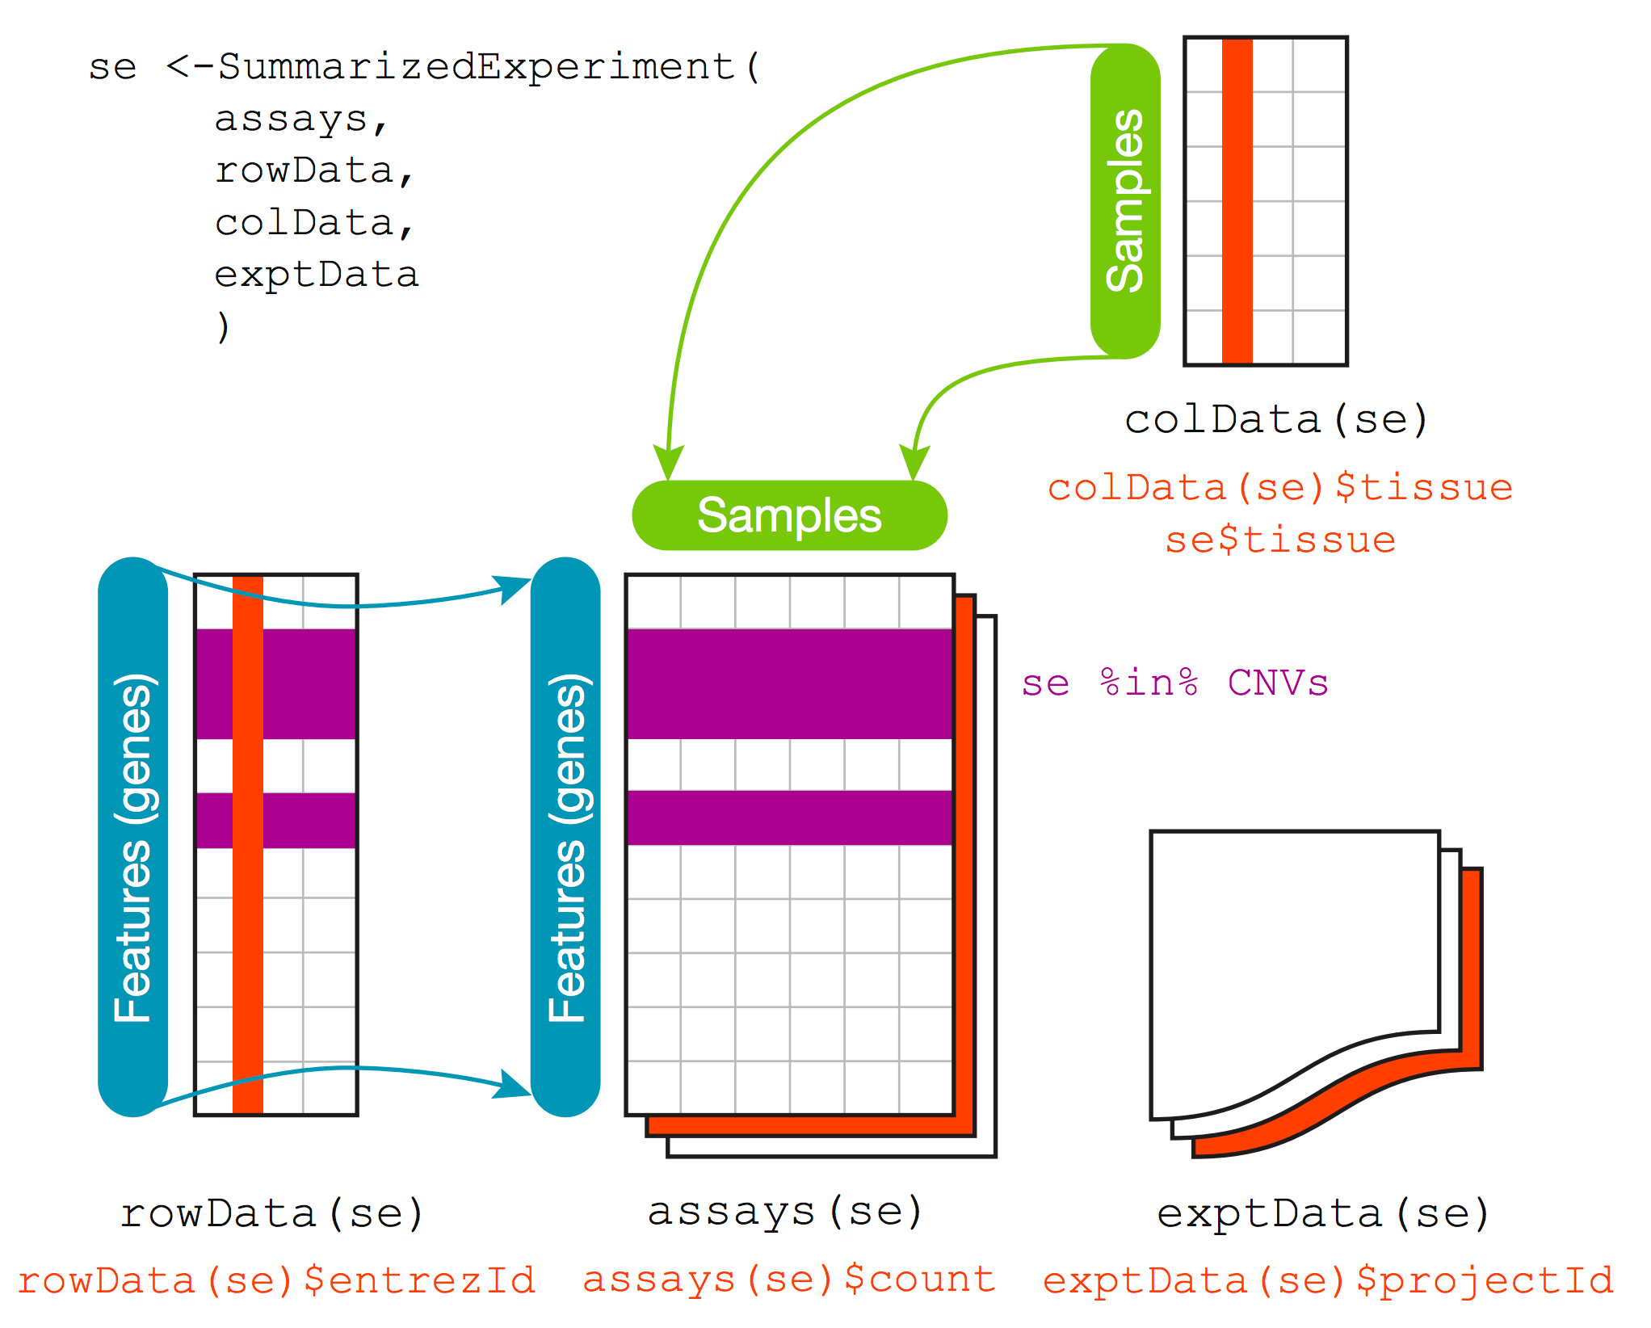
SummarizedExperiment
Notes:
Similar to ExpressionSet
More modern, not specifically made for microarray data, just general matrix data with row and column annotations
Can easily extend, MAST extends this object

Slide 41
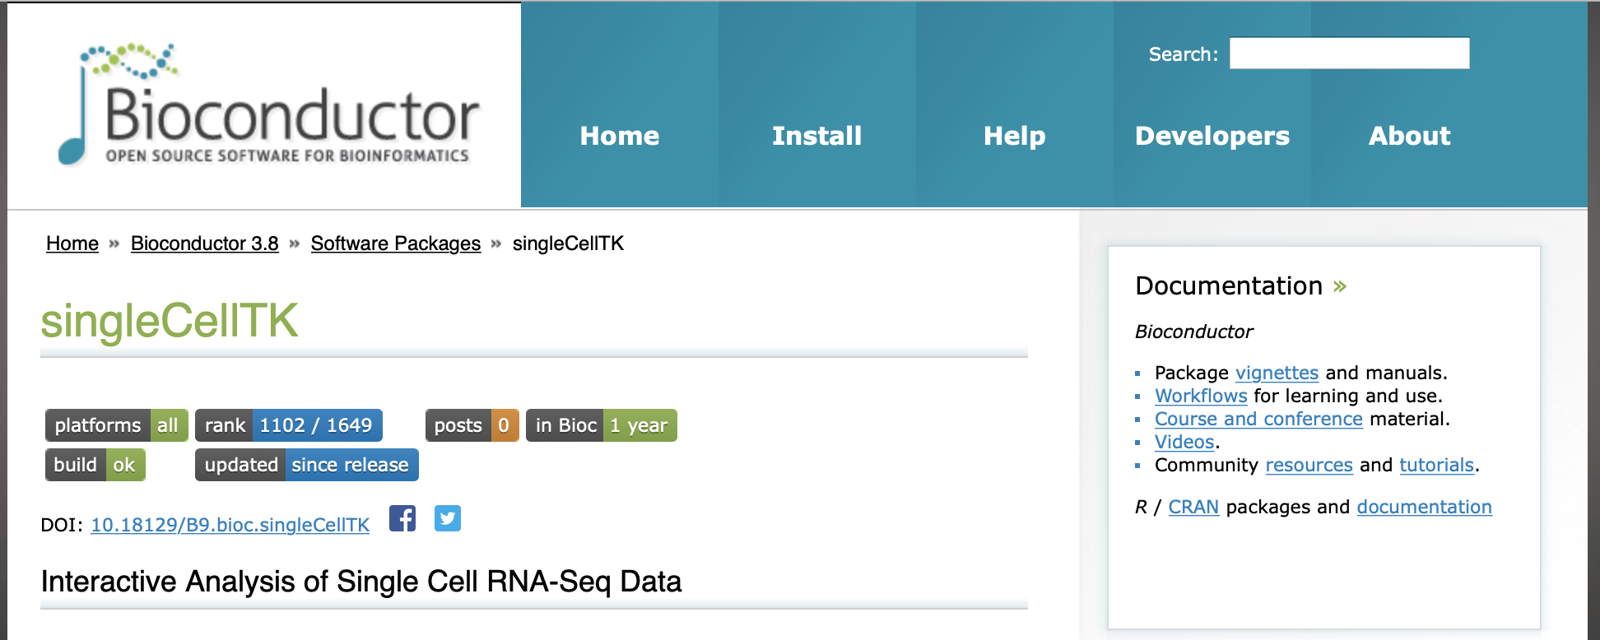
Single Cell Toolkit
Inputs:
RNA-seq, Nanostring, Proteomic, immunological assay data
Interactive analyses and visualization of data
Save results, figures, etc
Sophisticated data structures
R/Bioconductor package
Funded by: U01CA220413

Slide 42
